Slide 1
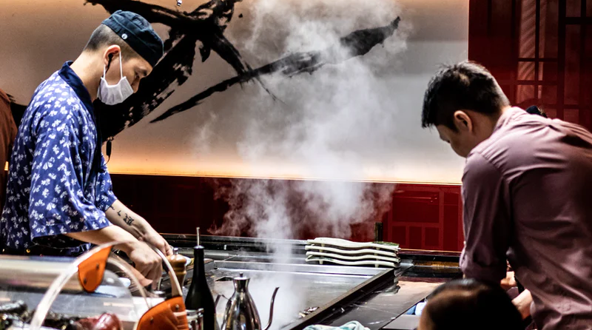

Bringing Teppanyaki to Life
Team #47

Slide 2



Objectivess
KPIs
1. Promote delivery & takeout volume by optimizing consumer experience with digital transformation.
Profit post COVID-19
Number of Delivery
2. Develop a diversified revenue portfolio by entering the private chef market (Omakase).
Number of Omakase
Number of Reservations
3. Maintain healthy margins via premium rebranding and a reservation-based demand assessment system.
Number of Employees
Omakase Penetration
Health & Safety
Culture
Financials
COVID-19 Protocols
Employee Engagement
Profitability Analysis
Takeout & delivery promotes safety for guests & employees
Divided private rooms
Dine-in operations
Transparent communication
Support for employees
Career exploration
Diversified revenue portfolio
Reservations assess demand
Premium re-branding increases profit margins
Notes:
Kevin

Slide 3

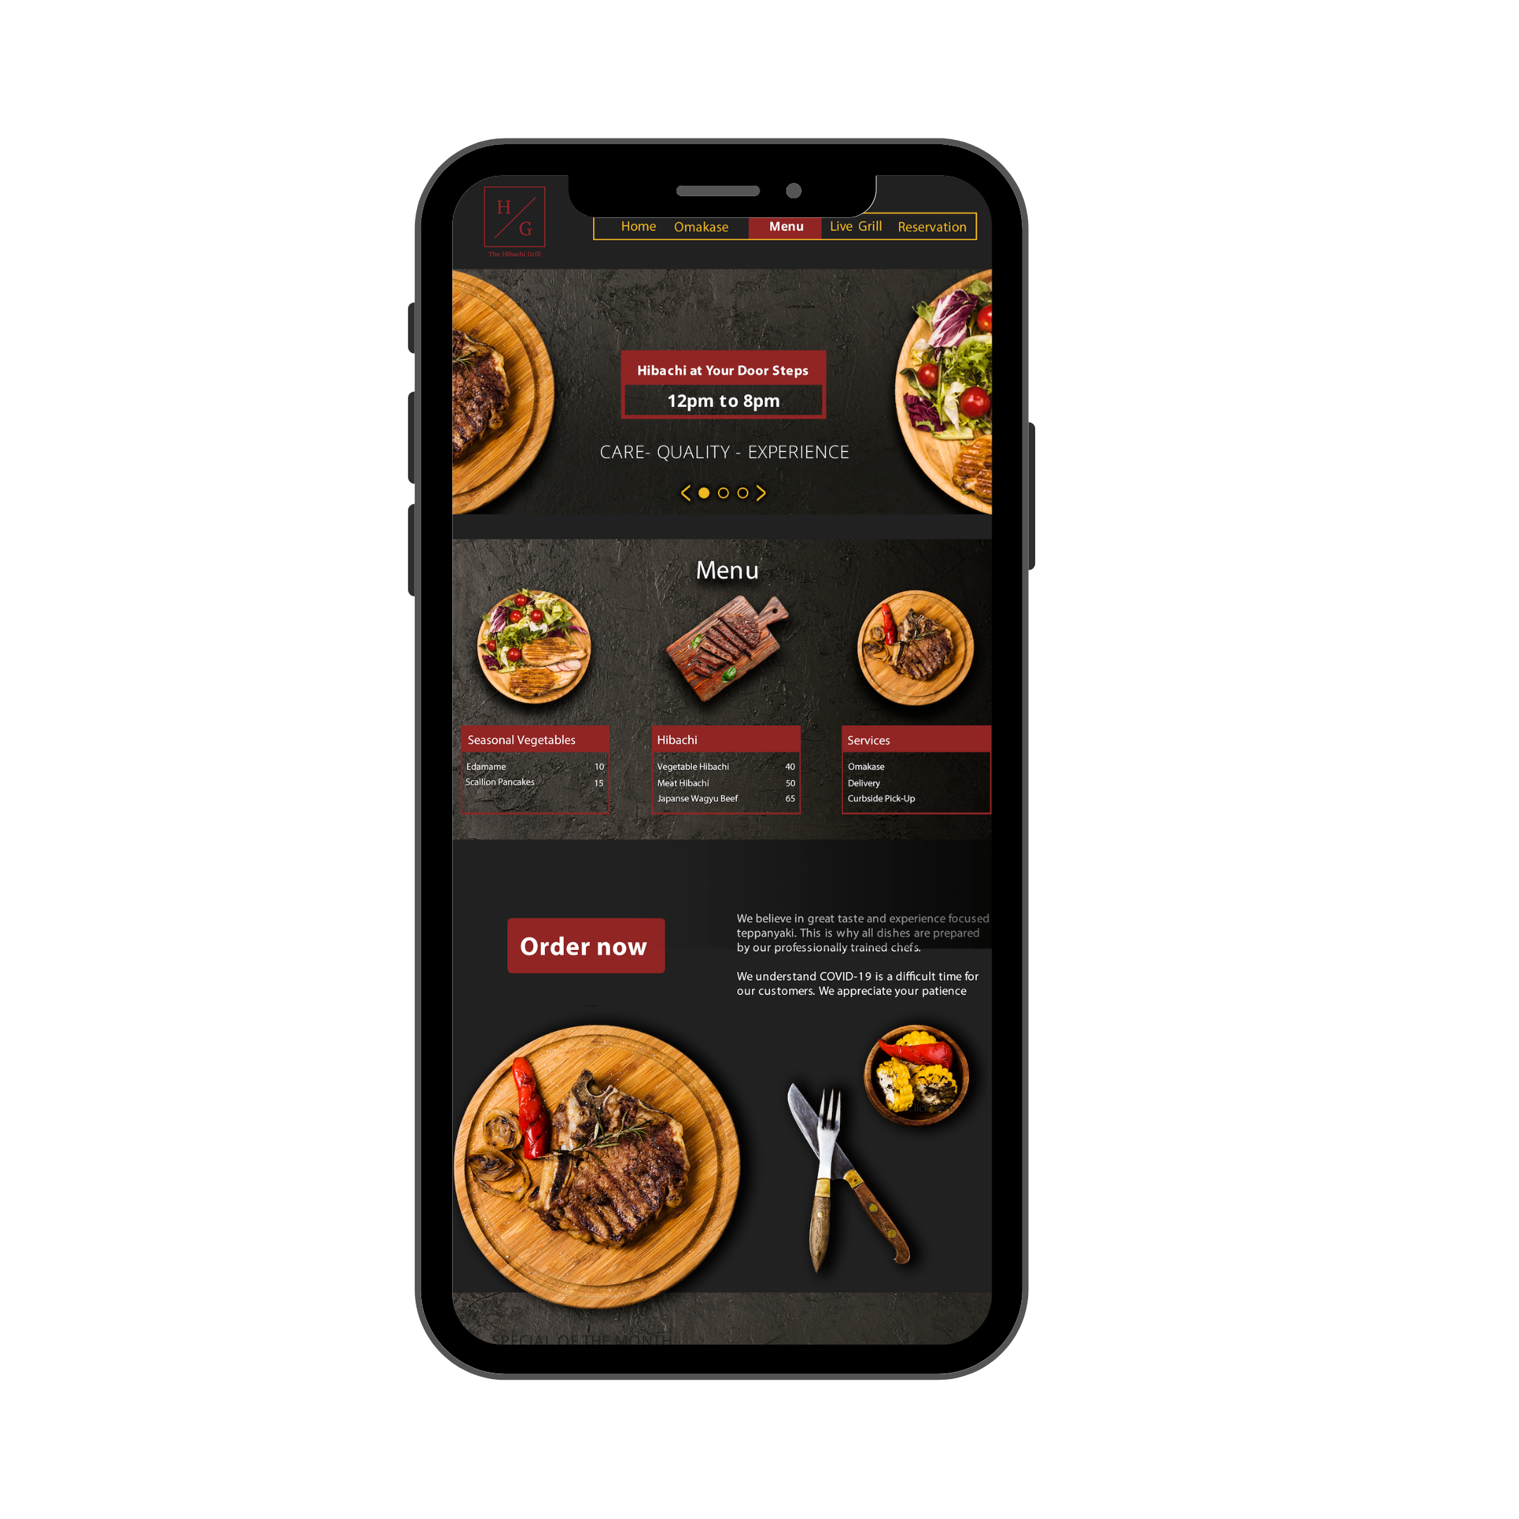





Enhanced digital presence focused on consumer needs and safety
Delivery & Pick-Up
Consumer Research
Digital Transformation
Live Grill
Rebranding
60% of respondents
regularly order Southeast Asian cuisine
Preserve the hibachi experience by watching your food being prepared.
Improve consumer engagement through a new website with CRM functions.
25% of respondents are more likely to order delivery if a livestream grill is available
Third Party Apps
Live Tracking
Promote market presence and penetration by utilizing Grubhub, Doordash etc.
Enhance consumers’ experiences with contactless delivery and live updates.
47% of respondents have ordered delivery & pickup more often in the last three months
Storytelling
New Menu
Highlight the stories of our chefs, waiters, and hosts and their culinary journey.
Increase average margins per bill by increasing menu prices.
Source: Consumer research study
Notes:
Kevin

Slide 4
Private chef market appeals to rising consumer needs
Omakase
Market Analysis
COVID-19 Impact
Among the top 50% of 300,000 households in Philadelphia³
Experiment new brands
87,000 households are interested in private chef services
More than 75% of consumers have experimented with a different shopping behavior during the crisis, such as trying new brands and will likely continue after COVID.¹
25,600 households are interested in Southeast Asian cuisines
Rise of at-home travel
0.45% market capture to breakeven (5 events per month)
Consumers are looking for ways to engage in travel-like experiences. Airbnb launched online experiences and famous landmarks now have virtual tours available.
Opportunity & Synergies
Health & Safety
1. Lack of Competition: lack of teppan-private chefs
2. Low Fixed Costs: omakase training and indoor grills
3. Cost Synergy: ingredients sourcing and labor
1. Screening: guests and chefs must answer COVID-19 questionnaire
2. Service: chefs will maintain distance and wear masks
3. Contact: tracking and transparent communication
Desire for social interactions
Search interest in “watching together” is up over 4X since early January. Consumers are seeking for new activities to do with their respective families.²
Source: McKinsey, Google, U.S. Census
Notes:
All Chefs are briefed and will follow the strict CDC guidelines for food sanitation and hygiene including the frequent washing of hands.
Any Chef that feels ill or has been in ANY contact with the virus WILL notify us immediately and we’ll take the proper steps to substitute for your event. We’ve even incentivized the Chefs for doing so.
Chefs will NOT shake hands or touch customers in any way.
Our Chefs do NOT handle any cash or payment transactions.
We’ve modified our cancellation and refund policy as well. We know a lot of planning is last minute now, so it is TWO days before your event for any refunds or cancellations (down from one week).
Safety concerns will not be an issue
Chefs must consent to working on Omakase and dine-in operations before receiving training
Chefs will receive hazard pay for working on Omakase
Market size does not include consumers that would be deterred by safety concerns
Safety concerns are expected to decrease over time, and Omakase is a long term investment, with low breakeven requirements.
However, utmost safety measures will still be required for all employees.

Slide 5
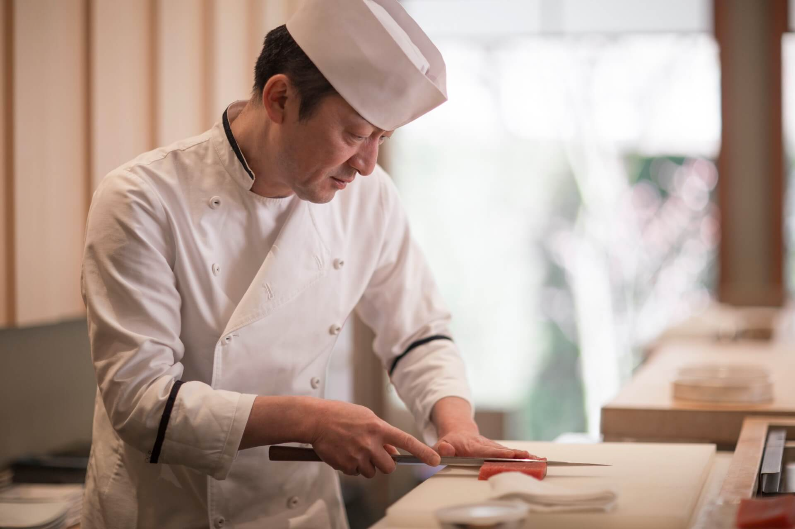
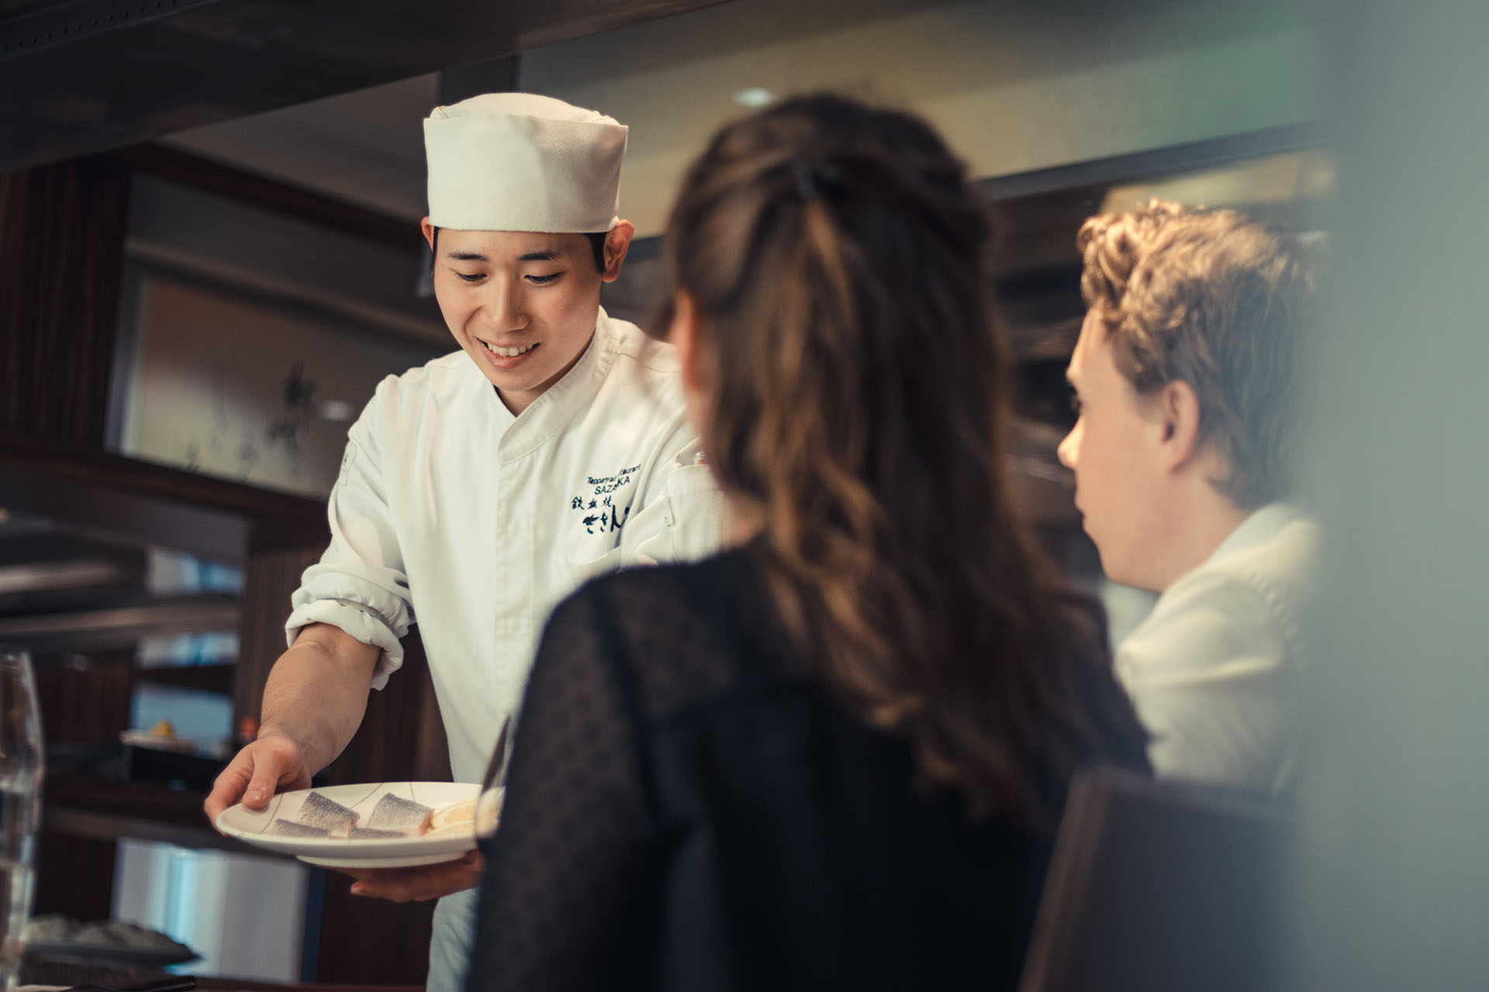
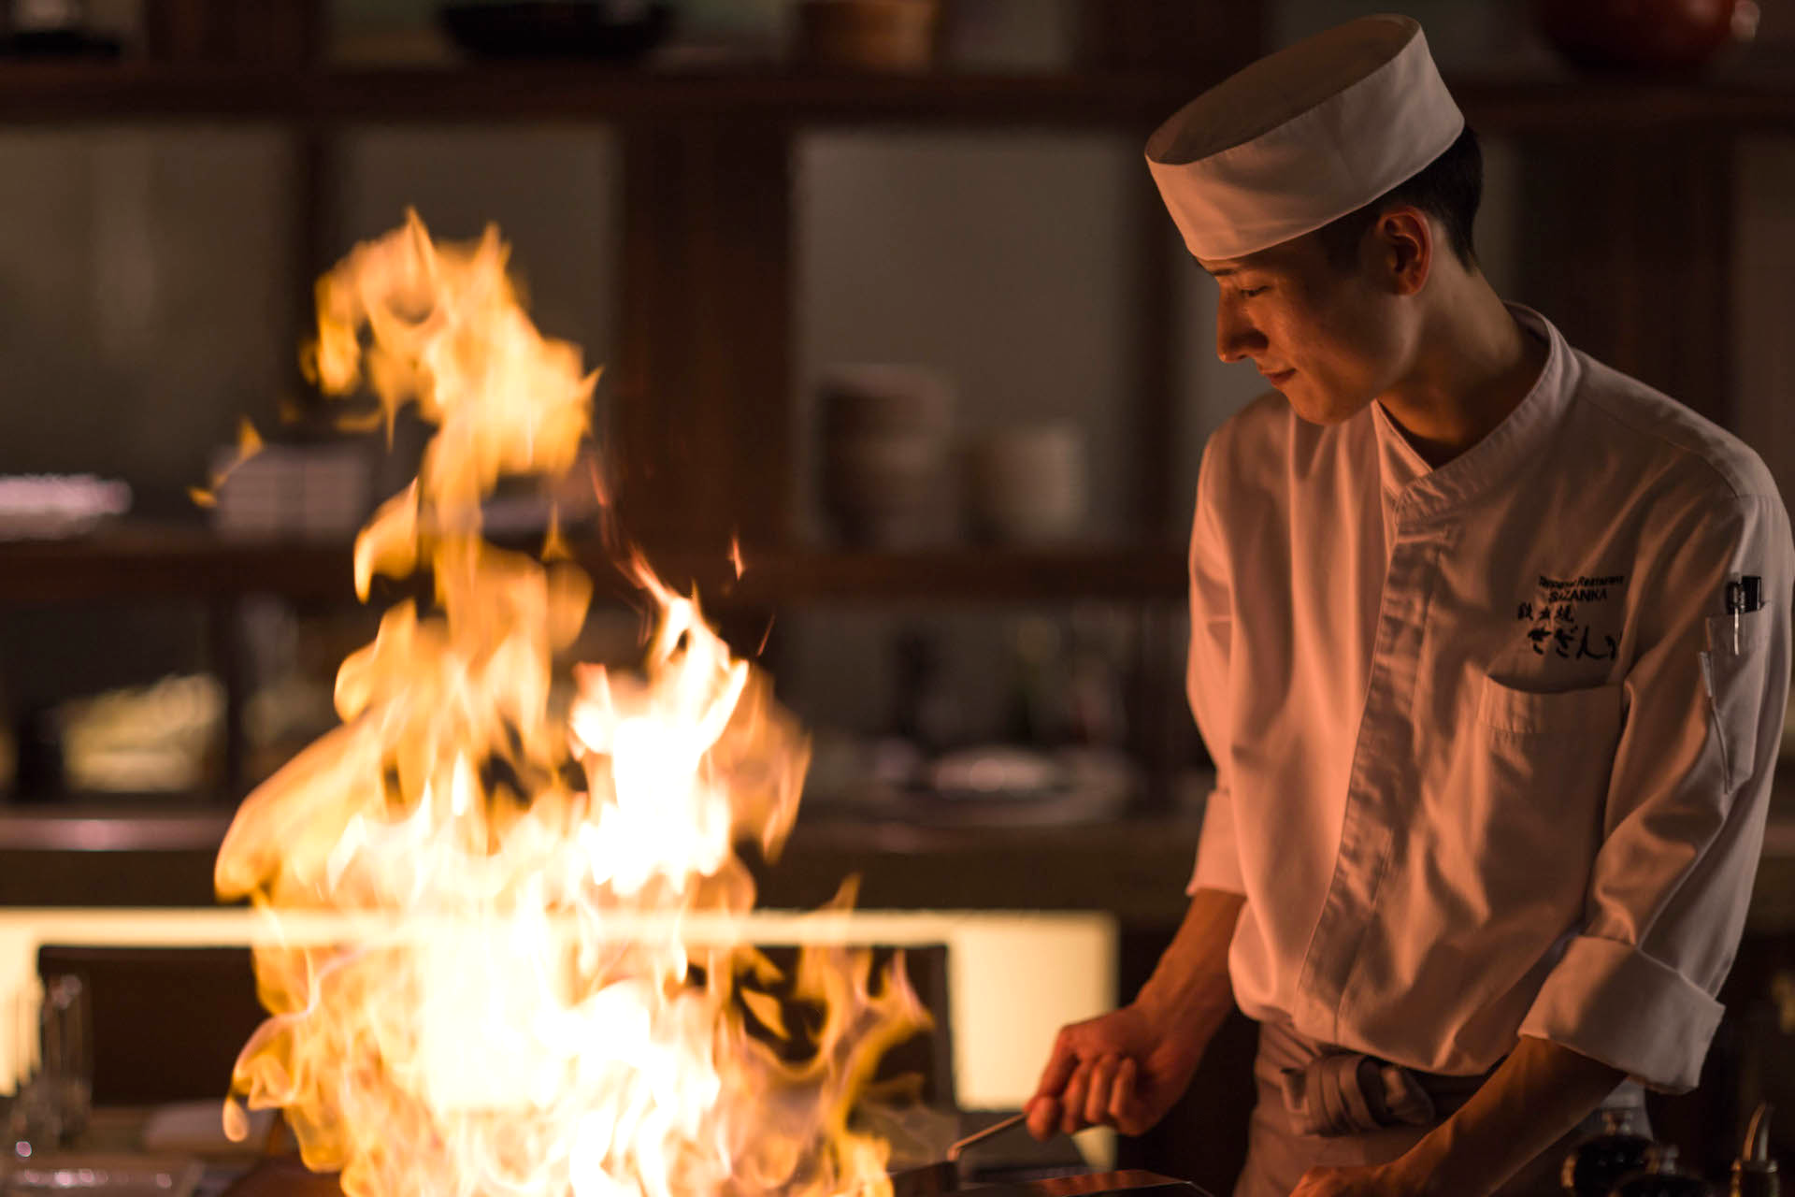
Omakase is a private teppanyaki chef service that brings Japan to your home
Omakase
Impact
130
Avg. profit per omakase
5
Events per month per chef to breakeven
Quality
Care
Experience
With the freshest and most exclusive ingredients using bincho-zumi, a smokeless charcoal, we can bring the authentic teppanyaki experience to your home.
Our chefs are professionally trained in Japanese history, cuisine, and etiquette. We provide full-service from equipment, ingredients, to cleaning.
Celebrate your special occasions at home. Gather around expert teppanyaki chefs as they prepare dishes with flair and precision right before your eyes.
13,000
Expected Monthly profit
at 5% Market Penetration
See appendix for more detailed projected financials
Notes:
this is a new venture
Even after covid stops, we have sourcing from japan (we can explore either continue this service or move in store for premium)
This is omakase slide

Slide 6
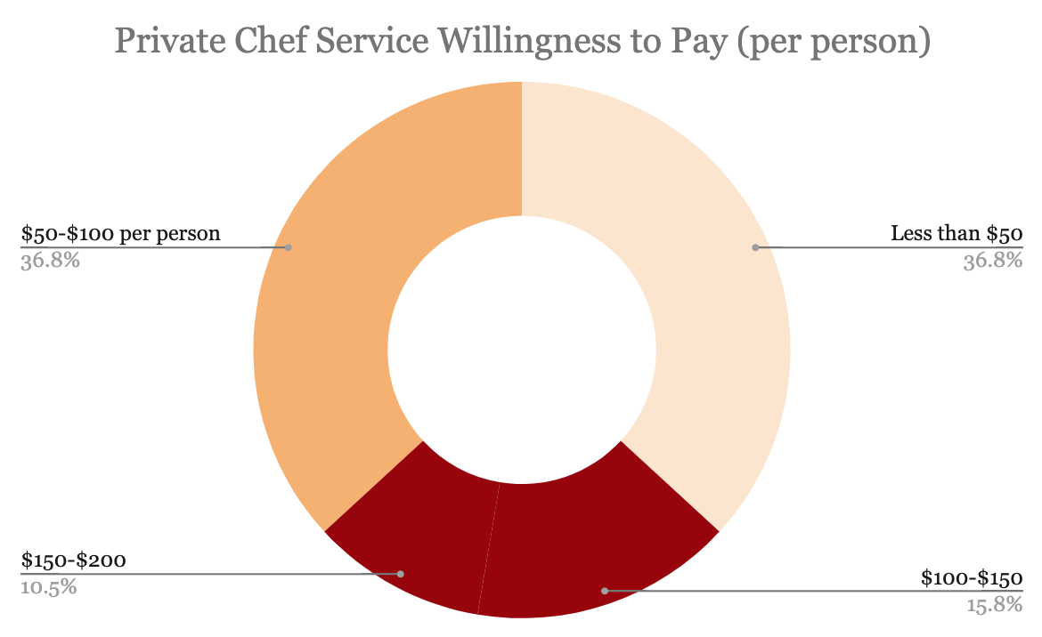

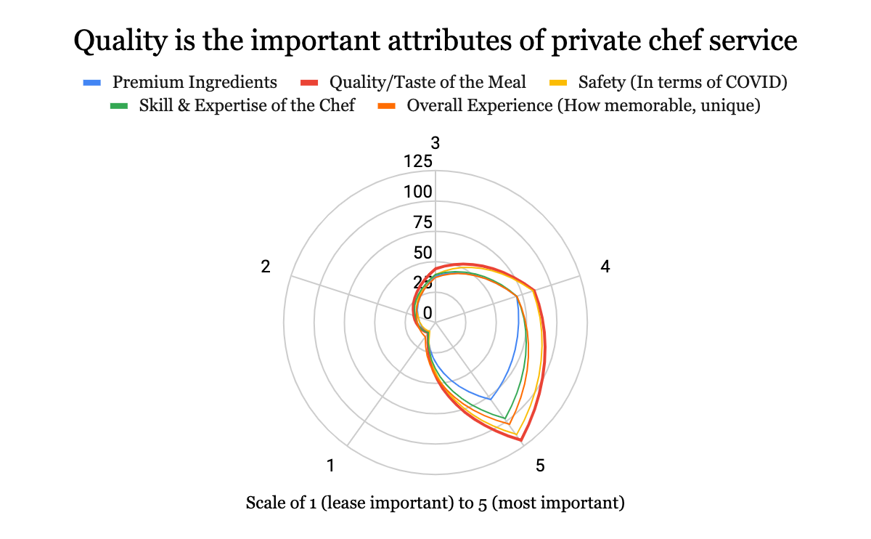

Profile
Most Used Social Media
Quality is the most important attribute for target consumers
Omakase
Age: 33 years
Location: Philadelphia
Job: Consultant
Gender: Female
What They Look For
Instagrammable
Ethical Sourcing
“I need new experiences that lets me see the bigger world, take new photos for my feed, and meet my friends for a nice meal.”
Personalized Service
Exclusivity
Purchase Behavior
$80
$40
$20
Source: Survey Results

Slide 7

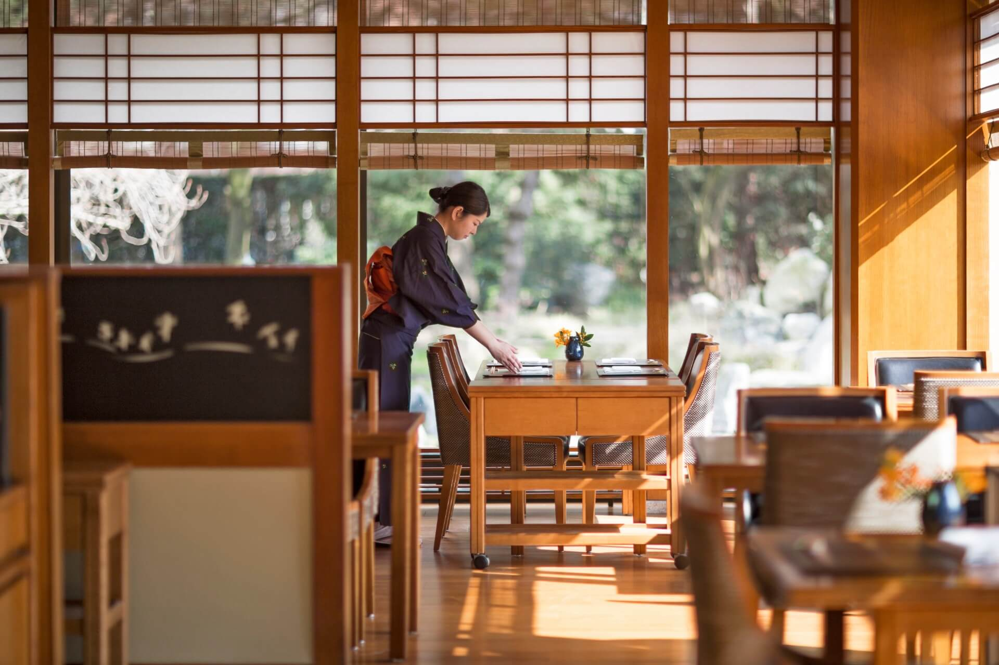
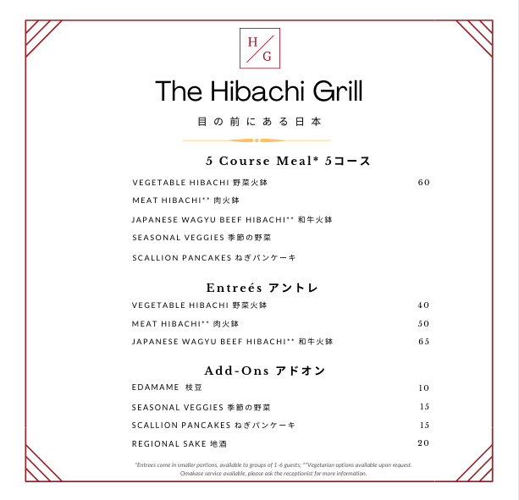
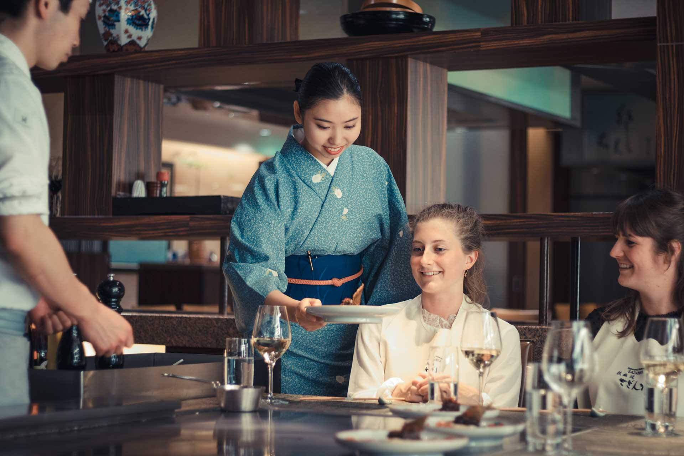
New dine-in operations focused on quality, experience, and high safety measures
Re-Opening
Reservations
Safety
New Menu
Opening Plan
Guests must make reservations in advance
Assess demand to scale labor supply to maintain healthy margins
7 divided rooms with individual grills
Increased cleaning budget and regulations
Employees and guests must follow strict safety guidelines
Higher quality means higher prices
Higher price means higher wages
Sushi has been temporarily removed due to health risks
Dine-in expected for Fall 2021
(vaccine distribution)
Limited dine-in before Fall 2021, dependent on demand and legal restrictions
Notes:
helen

Slide 8




People Over Profit: investment in restaurant talents and advancing career opportunities
Culture
Past employees will be given priority consider-
ation for future positions. To further show commitment to the employees, we recommend the owner to allocate her own salary to help her laid-off employees.
Professional training to prepare chefs for omakase services. We will allocate up to $8000 per month for training costs and provide in-training chefs with a weekly stipend. Upon reopening, dine-in chefs will also receive a salary increase by $4/hr.
To ensure that all of our employees can arrive to work safely, we will provide carpool, housing stipends, and COVID-19 hazard pay to alleviate our employees’ stress in transitioning during this difficult time.
To help our team build and stay connected during the COVID-19, we will implement all expenses paid omakase practice sessions, weekly virtual happy hours, and weekly mental health webinars.
Communication
Career Advancement
Employee Benefits
Team Building
Notes:
helen

Slide 9
Financial Strategy: maximize synergy and minimize risks
Financials
Number of Employee Shifts
Assumptions
Monthly Fixed Cost of up to $16,300 for rent and utilities.
Number of shifts will be scaled based on consumer demand as managing labor expense is the most crucial to ensuring profitability.
Omakase break-even refers to number of Omakase needed per chef to be able to pay all Omakase chefs, a full-time minimum wage regardless of demand.
2020 Q3
2021 Q1
2021 Q4
Chefs
Waiters
Delivery Drivers
Chefs-In-Training
Financial Analysis
Synergies
2020 Q3
2021 Q1
2021 Q4
Digital Transformation
Delivery & takeout supports fixed costs and future investments
Revenue Diversification
Diversified portfolio promotes financial health
Long term revenue potential even post-COVID-19
Premium Rebranding
Increase profit margins with higher prices
New menu cuts lower margin items and increases supply chain efficiencies
Daily Delivery/Takeout
Weekly Omakase
Daily Occupancy
19
30
19
1.25
30
30
19
1.25
60%
30
30
75%
Break Even
Projected
Notes:
xyz

Slide 10
Ensuring sustainable future growth: implementation timeline, risks, and mitigation
Operations
Probability of Risk Occurring
Risk Mitigation / Solutions
Low
High
Higher Rent/Utilities Expenses
Reduce employee’s pay
Raise menu prices
Lower Delivery/Takeout Demand
Scale down third party deliveries
Eliminate delivery in favor of pick-up if needed
Lower Dine-In Demand
Reservation system prevents excessive labor
Extend closure time
Increase marketing for delivery
.
Lower Omakase Demand
Reduce Omakase chef count to meet demand
Eliminate Omakase if breakeven not met
Longer Restrictions
Maintain Delivery Profits
Reopen for limited dine-in operations
A
Lower Omakase Demand
C
B
Low
E
Longer Restrictions
C
Severity of Risk
D
Lower Dine-In Demand
D
Lower Delivery/Takeout Demand
B
High
A
Higher Rent/Utilities Expenses
E
Notes:
Helen
Menu in appendix
5 ft spatula how does it keep consumers safe?

Slide 11
Ensuring sustainable future growth and KPI impact
Operations
Implementation Timeline
Activity | Phase 1 | Phase 2 | Phase 3
 | Rest of 2020 | Early-Mid 2021 | Fall 2021 +
Website Design + Launch
Delivery/Pick-Up Service
Chef Enrichment Program
Omakase Service
Employee Housing Subsidy
Menu Redesign
Other Rebranding Initiatives
Dine-In Renovations
Dine-In Service
KPI Performance
Revenue Post COVID-19
+204%
Number of Omakase
25/wk
Number of Employees
+350%
Number of Delivery
210/wk
Number of Reservations
50/day
Omakase Penetration
+5%
Phase 2: Omakase Preparation Completed
Phase 3: Philadelphia Restaurant Restrictions Lifted
Notes:
Helen
Menu in appendix
5 ft spatula how does it keep consumers safe?

Slide 12
Appendix

Slide 13

Brand Positioning Digital Assets
Updated brand assets to reflect new positioning
Appendix
Experience-First Teppanyaki
Mission
Passionate about experience-driven teppanyaki, elevated through our digital presence, we aim to improve our respective communities through
our class of trade.
Simple: quality-driven ingredients sourcing
Elegant: authentic Japanese experience
Brand Images
Household Name: product lines designed with care, experience, and quality

Slide 14
Digital Website Explained
New website highlighting product offerings powered by Shopify
Appendix
Website Details
Storytelling
Life grill
Reservations
Omakase booking
$29/month
The website will be hosted by Shopify basic monthly plan. In addition, the web development tool also offers existing templates for restaurant ordering
Website Features
SSL certificate
Unlimited products
Order creation
Gift cards
Professional reports
Digital payment
Inventory management
Source: Shopify

Slide 15





Delivery & Pick-Up Pricing Examined
Consumers are more receptive to increase prices than surcharges
Appendix
Delivery Services
Specialty
Fast delivery | Alcohol available | Consistency | Easy Payment | Food & more
15% | $1.95 | 7-15% | 3.05%+0.30 | $1 merchant fee
Best for large orders given the service fee | Typically delivered on a bike to cut cost of delivery | Better salary for delivery workers | Most widely utilized delivery service | Highest purchase total with options to purchase non-meal items
Service Fee
Description
Source: TechCrunch; WLWT5

Slide 16
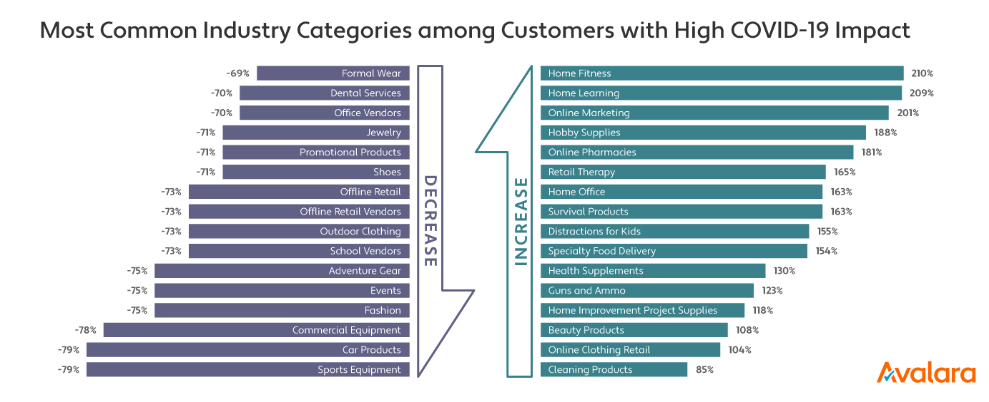
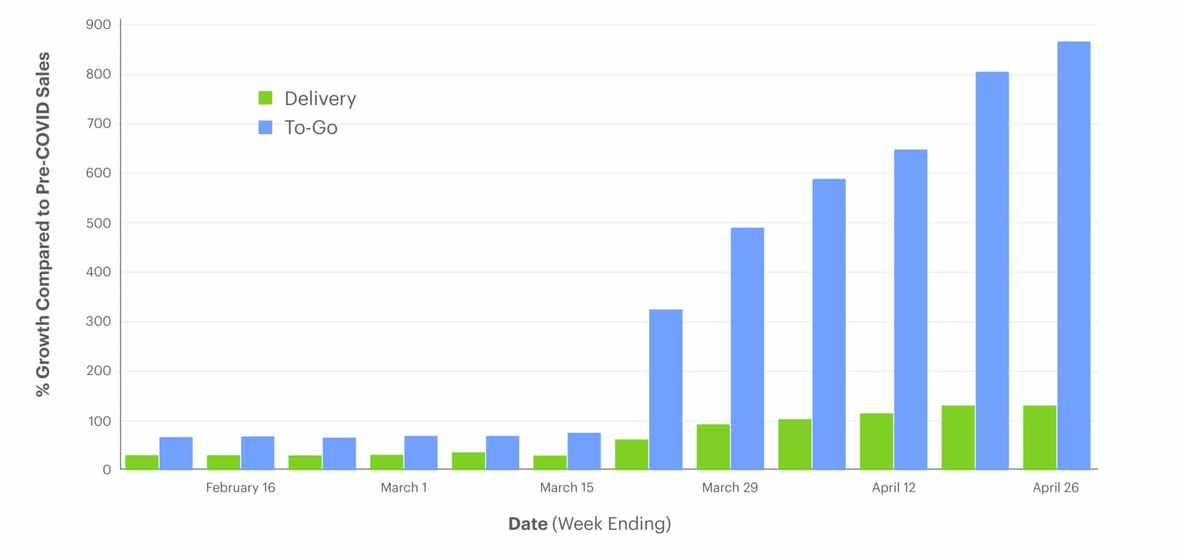
Delivery & Pickup Demand Explained
Increase delivery penetration as the growth driver of restaurants
Appendix
154%
increase in food delivery services during COVID-19
900%
growth compared to COVID-19 delivery sales
Source: Upserve; Avalara

Slide 17
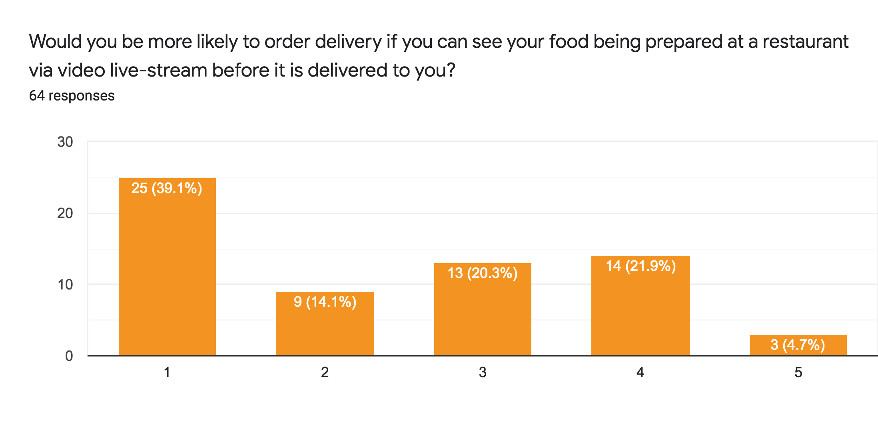
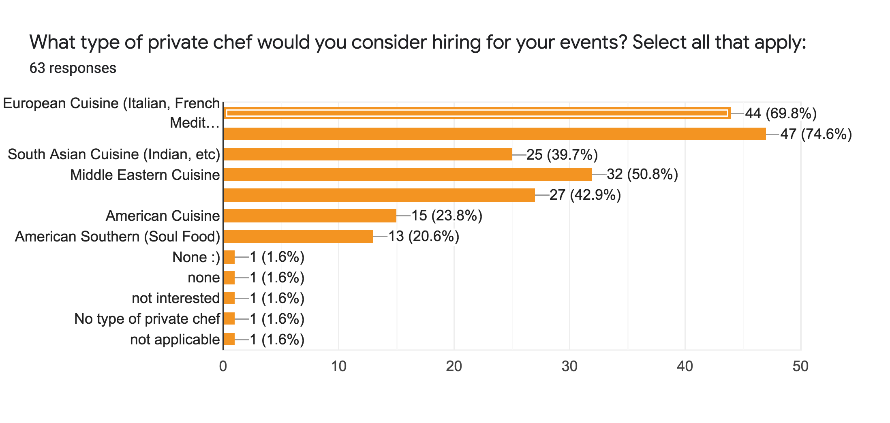
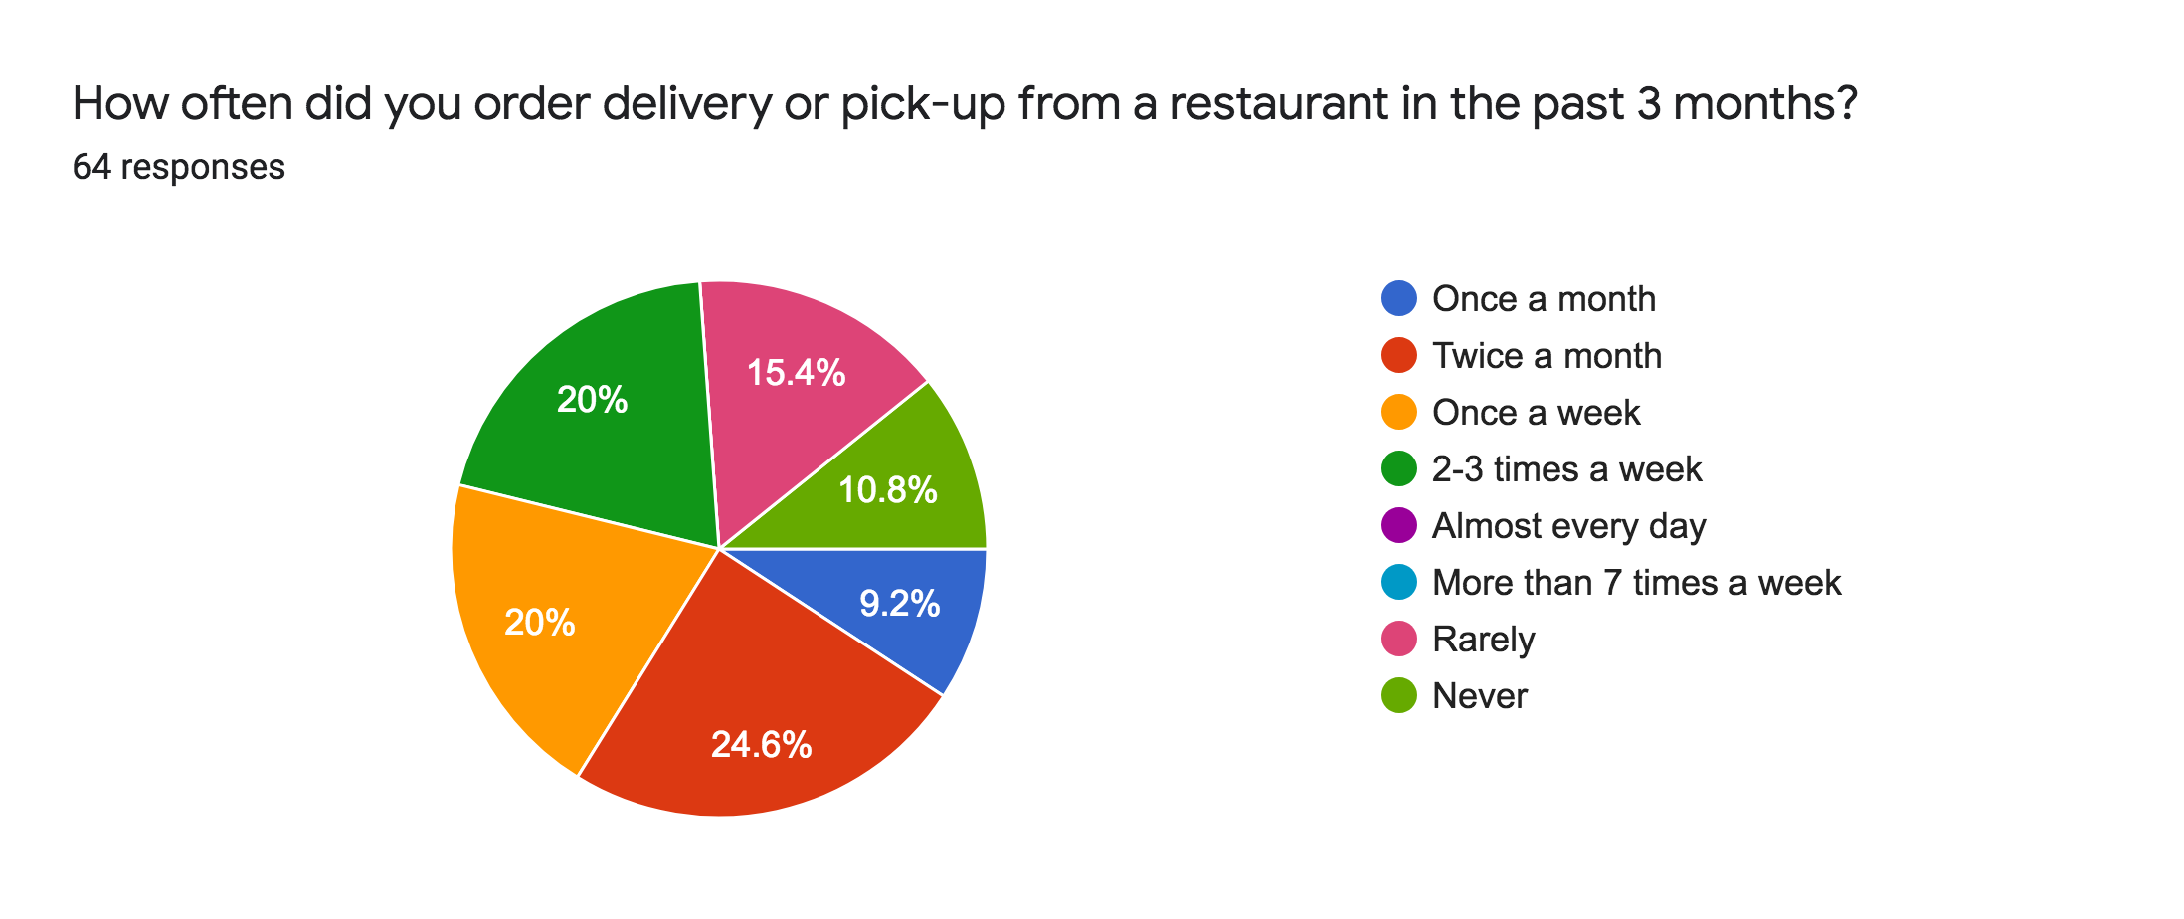
COVID-19 Consumer Sentiments Analysis
Survey Results & Interviews
Appendix
“We use DoorDash and get around 200 takeout orders on a good day” - Sakura Japanese Restaurant (Hibachi Restaurant in Bensalem, PA)

Slide 18






Private Chefs Market Analyzed
Teppanyaki private chefs is an underserved market
Appendix
Product Portfolio
Price
Cozymeal: cooking classes, mixology classes, team building activities, and private chef experiences
MyTable: meal prep, cooking classes, dinner experience, catered event
Table at Home: dinner parties, private lessons, and small catering events
Take A Chef: private chef
Monetization Strategy
Quality
Cozymeal: diversified product portfolio and serves as marketplace connecting chefs and customers
Table at Home: less quality focused but rather targets small social gathering
MyTable: mobile app available with live chat options to alleviate stress from purchases
Take A Chef: corporate partnerships with major tourism and hospitality players such as Airbnb and American Express
Source: Eater; COVID-19 on Private Chefs Industry

Slide 19
Private Chefs Marketing Plan
Go-To-Market strategy for omakase service
Appendix
Provide professional training for chefs on Japanese etiquette, culture, history, and home cuisines.
Obtain certifications including Pennsylvania Food Safety Training, Pennsylvania Food Handler, and Personal Certified Chef.
Leverage small business ad grants to advertise Omakase on Facebook, Instagram, and Google Search, as well as private chefs booking sites.
1
2
3

Slide 20
Omakase Financial Details
Appendix
All Chefs are briefed and will follow the strict CDC guidelines for food sanitation and hygiene including the frequent washing of hands.
Any Chef that feels ill or has been in ANY contact with the virus WILL notify us immediately and we’ll take the proper steps to substitute for your event. We’ve even incentivized the Chefs for doing so.
Chefs will NOT shake hands or touch customers in any way.
Our Chefs do NOT handle any cash or payment transactions.
We’ve modified our cancellation and refund policy as well. We know a lot of planning is last minute now, so it is TWO days before your event for any refunds or cancellations (down from one week).
Pricing:
$100 for children
$150 for adults
Assumption: $400 average revenue per event
Couple (2): $300
Family(3-5): $500-$600
Larger Event: (6+) At least $600
$200 per chef and $100 per person max 5
Omakase logistics
4 hours avg - Chefs paid $25 per hour (including hazard pay)
$400 avg revenue
Notes:
Omakase - can charge higher price for meal, use finest ingredients + skills, easier for them to plan food costs when purchasing
There are 600000 households in philly. Out of those, 300000 household repreesent the top 50% in income.

Slide 21
Omakase value proposition, risks, and synergies
Appendix
Value Proposition of Omakase
Revenue diversification for more stable profits and greater job security
Chef enrichment via training and increased pay for Omakase
Relatively higher margins compared to delivery margins and projected dine-in margins
Greater safety than dine-in, better experience than take-out
Increased employee retention
Safety concerns will not be an issue
Chefs must consent to working on Omakase and dine-in operations before receiving training
Chefs will receive hazard pay for working on Omakase
Market size does not include consumers that would be deterred by safety concerns
Safety concerns are expected to decrease over time, and Omakase is a long term investment, with low breakeven requirements.
However, utmost safety measures will still be required for all employees.
Omakase Synergies
Premium brand reinforcement
Cross-Training Chefs for Dine-In
New website provides platform for booking Omakase
Omakase can promote dine-in operations
Notes:
We trying to say why we should do omakase and what’s good about it.

Slide 22
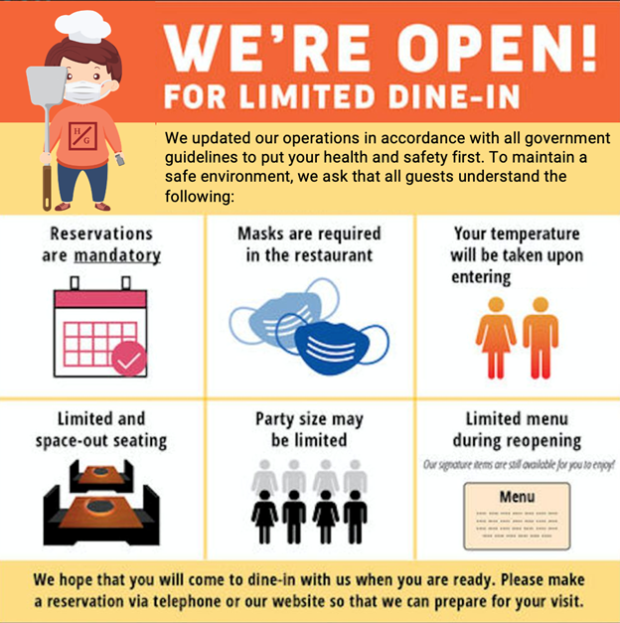
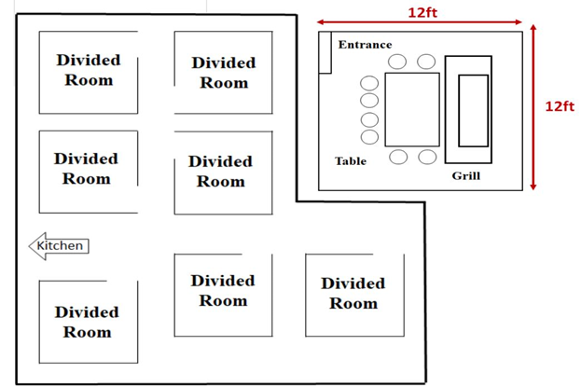
Reopening Operations Explained
Safety protocols integrated in communication and layout
Appendix
Friendly Communication
Dine-In Layout
Key Features:
Dividers to separate the rooms
Plastic barrier around the grill for extra protection
Chef will use 5 foot spatula to deliver the food to the customers
Sanitary station at the entrance

Slide 23
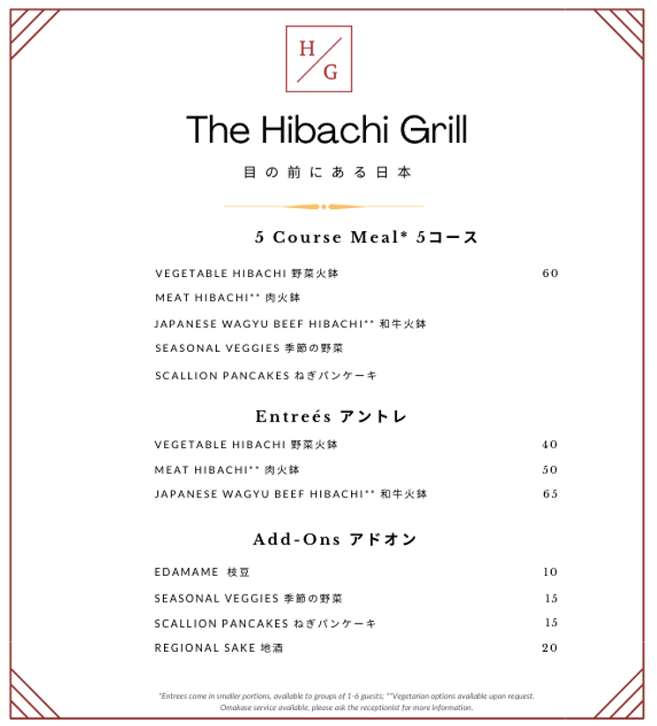
Menu adjustments explained
Menu revision optimized for supply chain efficiency
Appendix
Disposable, single-use
Dual languages
Sampling menu
Non-sushi items
Sake pairing
Customizable for dietary preferences
Notes:
Menu items such as sushi has been discontinued until further notice. The reasoning behind discontinuing sushi is simply because it is too much risk and not enough reward based on recent research on the following slide. We have also decided to raise menu prices instead of imposing a surcharge on the bill. The reasoning behind this is noted in the next page as well.

Slide 24
Menu adjustments explained
Safety of sushi has been tied to COVID-19 concerns
Appendix
Increase cost from safety protocols
Decrease consumer demand and increase supply restrictions
Food Safety and Handling
Food contamination
Exposure to parasites, and bacterial infections
Shorter storage time
Linkage to COVID-19
Beijing officials released ties of COVID-19 virus to salmon
Public fear towards raw seafood as potential source of virus has increased
Plummet Sushi Demand
60% decrease in raw ingredients sale in April
Conveyor belt sushi has been paused since March
Source: SeafoodSource; New York Times

Slide 25
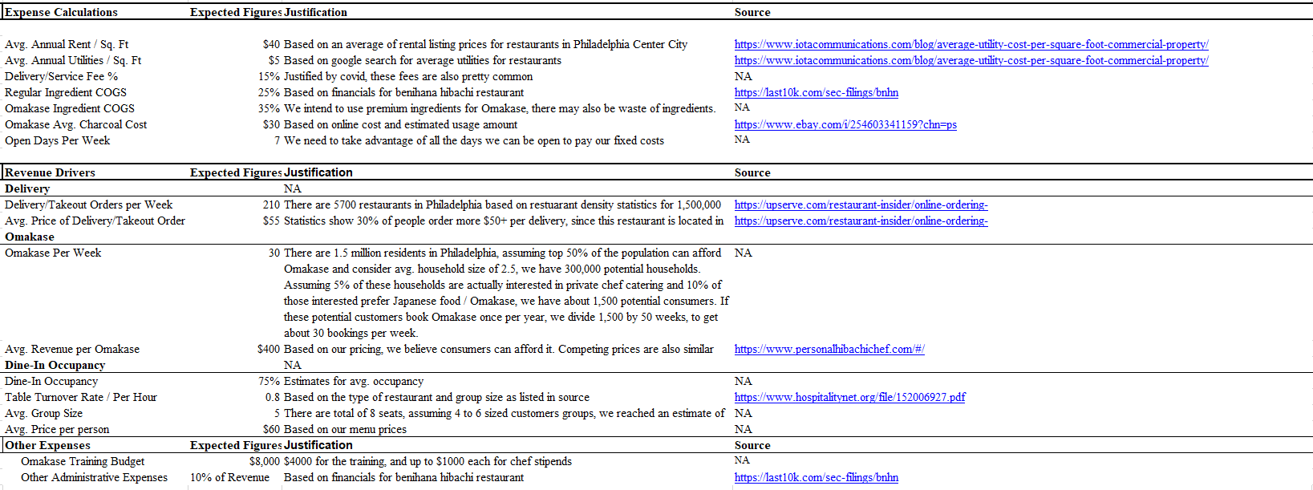
Scenario Justification
Appendix

Slide 26
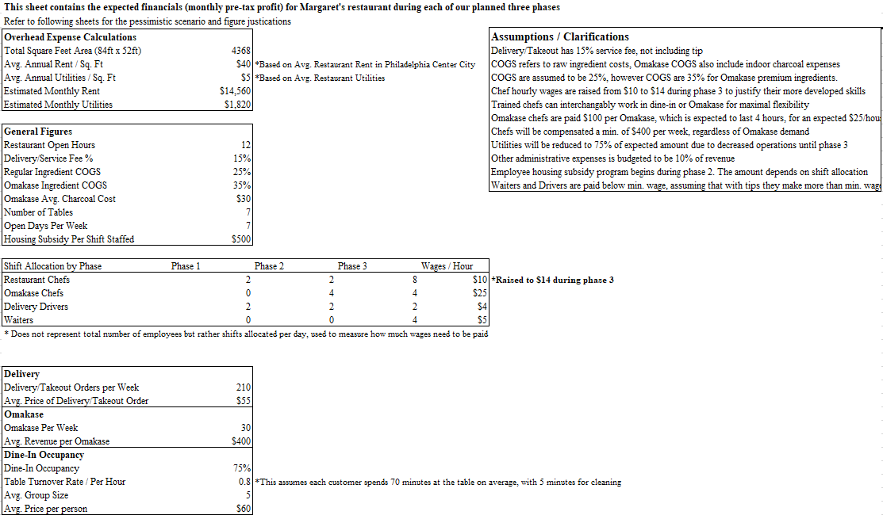
Financial Projections
Appendix

Slide 27
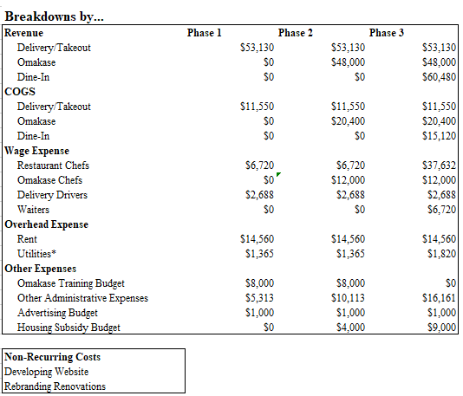
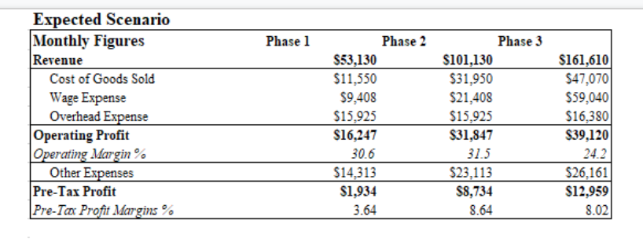
Financial Projections
Appendix

Slide 28
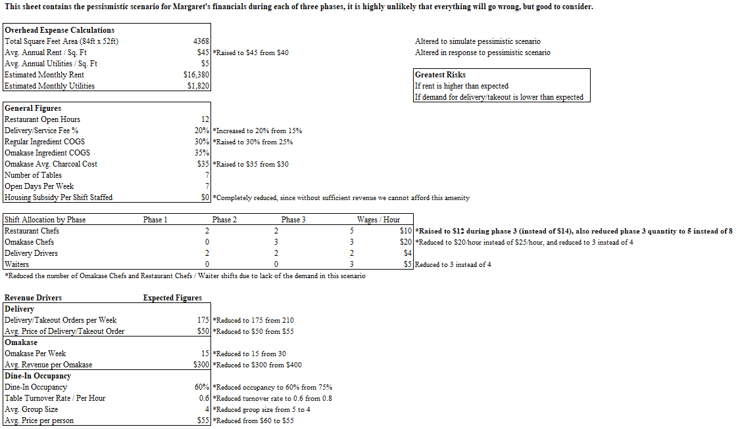
Worst-Case scenario financials
Appendix

Slide 29
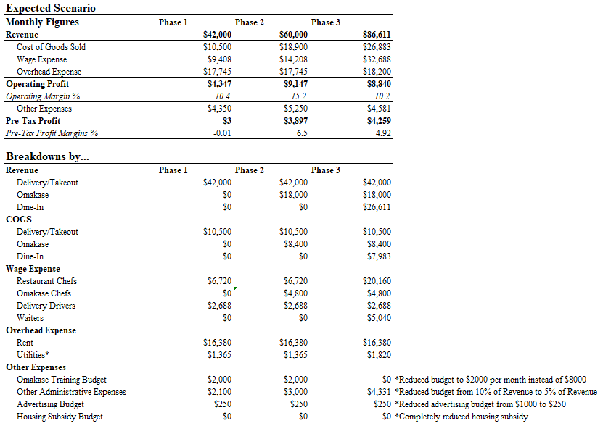
Worst-Case scenario financials
Appendix

